Slide 1

DATA MANAGEMENT 699 Analysis of Health Insurance Claim Data
By
Aayush Jannumahanti

Slide 2
Introduction
299.5
Million
People having Medical Insurance coverage in USA
[1]
68,000
Average number of claims in the country that saves lives
[2]
5.9
Million
People having Medical Insurance coverage in Maryland
[3]
1+ Million
Heart Diseases
Most common disease or accident on which insurance was claimed
[4]

Slide 3
About Dataset
DATA CATEGORIES
Patient Data
Health Insurance Beneficiary Data
ENTITIES
Inpatient Data
Outpatient Data
Beneficiary Data
*Data Source: Kaggle
Link: https://www.kaggle.com/code/rohitrox/medical-provider-fraud-detection

Slide 4
Dataset Description
1. InPatient
Volume of data: 50K records and 27 attributes
2. OutPatient
Volume of data: 643k records and 30 attributes
3. Beneficiary Data
Volume of data: 202k records and 27 attributes

Slide 5
Objectives
Understanding Data categories and the relationships between them.
Understanding the Anomalies
To get insights from the data

Slide 6
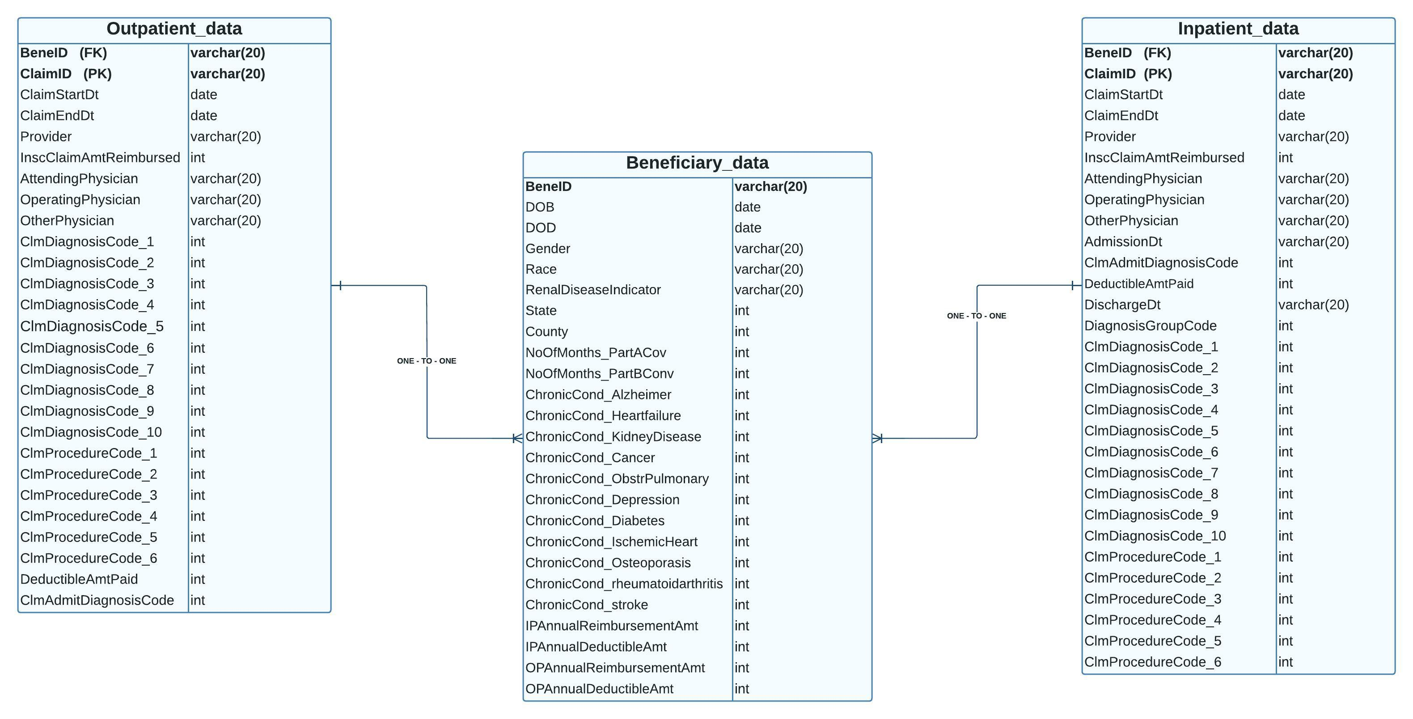
ER Diagram & Metadata

Slide 7
Technologies Used
AWS Glue
AWS S3 Bucket
AWS Athena
MySql Workbench
Tableau

Slide 8
Flow of Project
DATASET
AWS RDS
INTEGRATING WITH ATHENA
AWS GLUE CRAWLER
INTEGRATING WITH TABLEAU FOR VISUALISATION
Querying
ANALYSIS

Slide 9
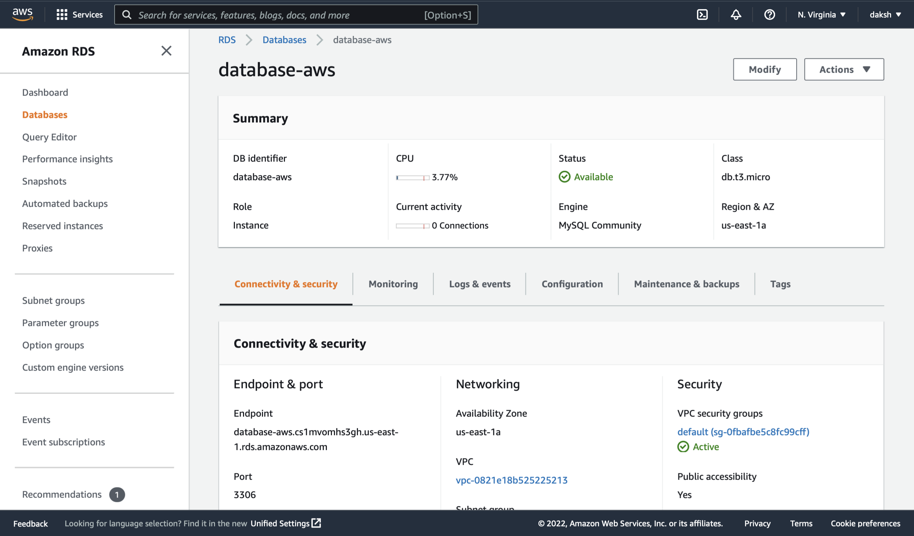
AWS - RDS

Slide 10
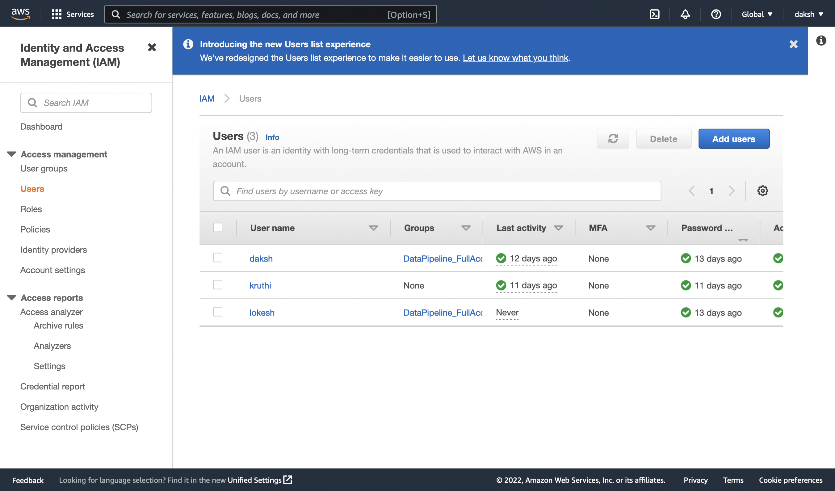
AWS – IAM ROLES

Slide 11
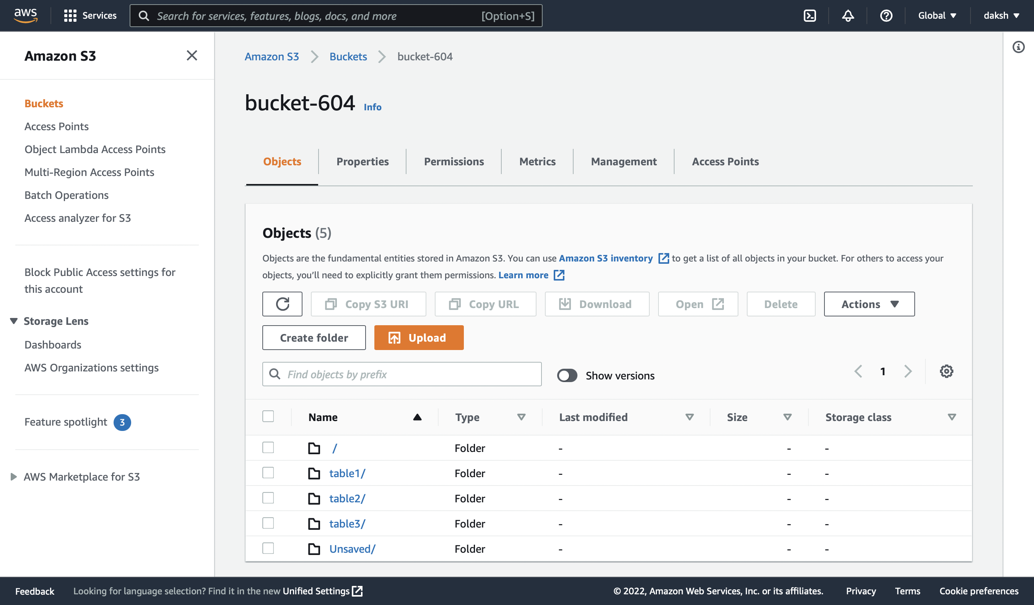
AWS – S3 Bucket

Slide 12
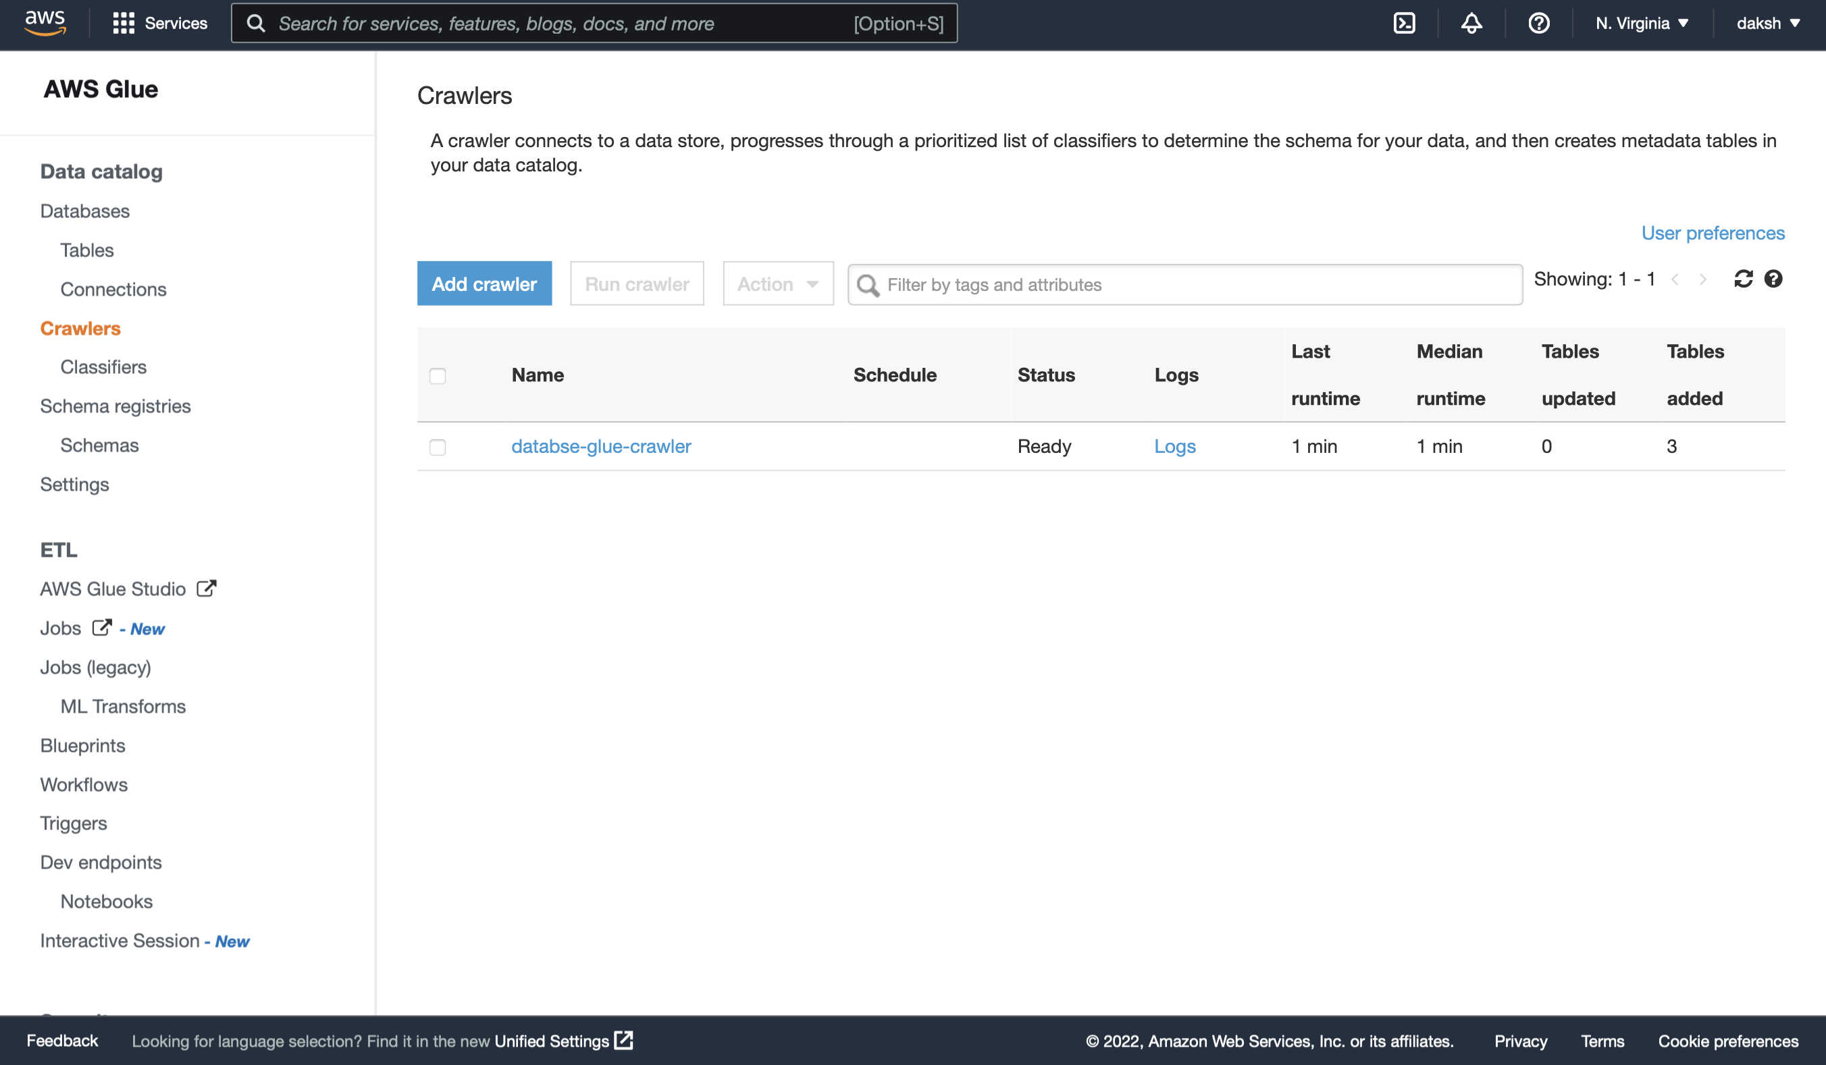
AWS – GLUE CRAWLER

Slide 13
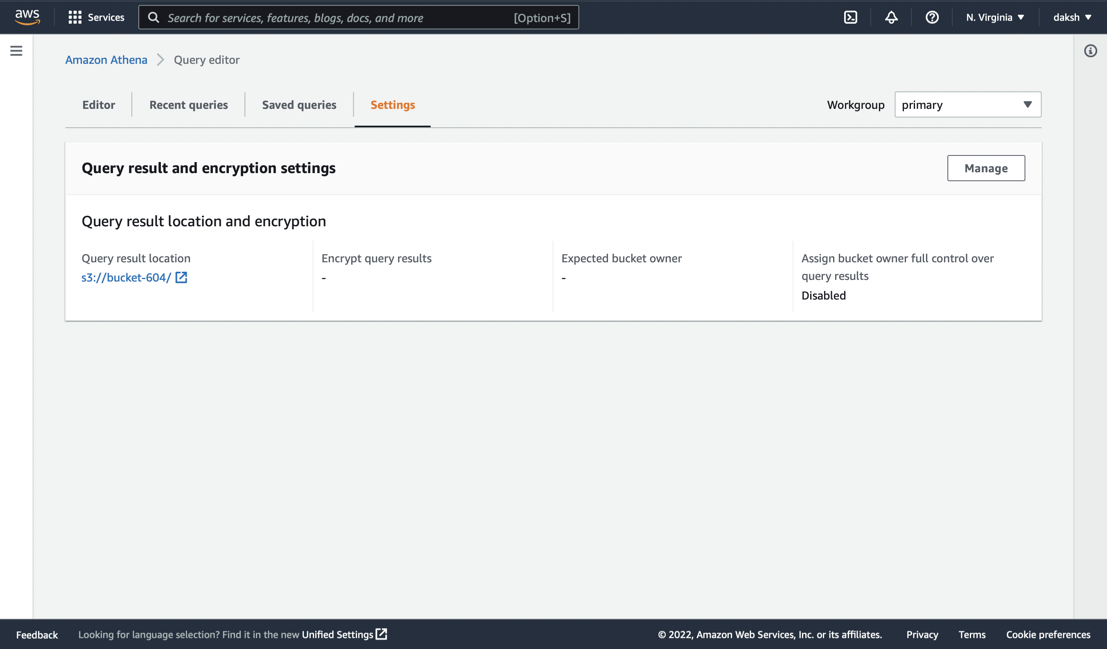
AWS – Athena

Slide 14
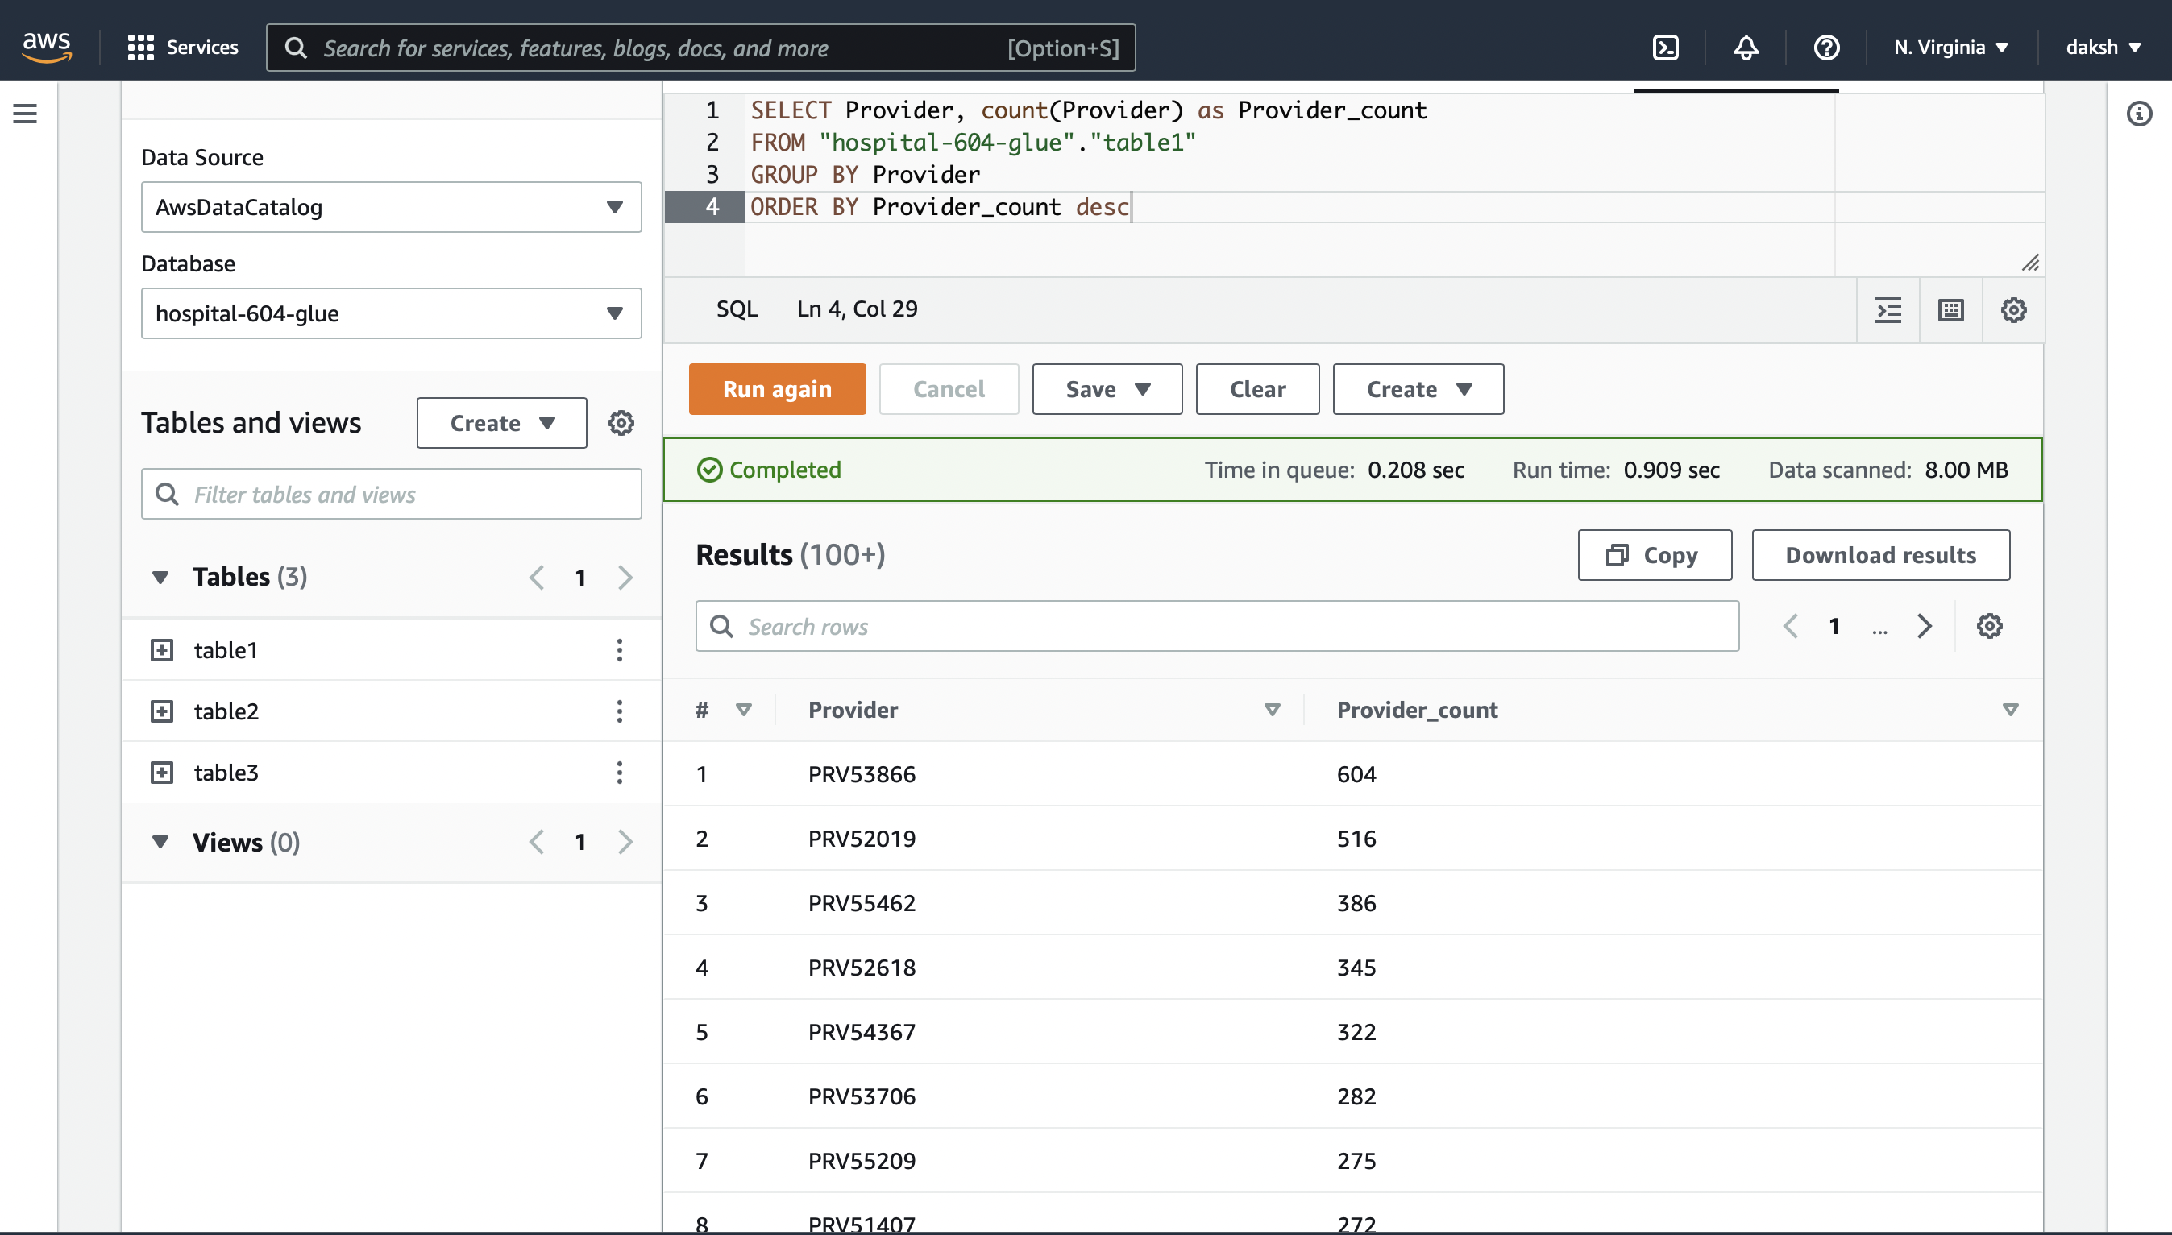
AWS

Slide 15
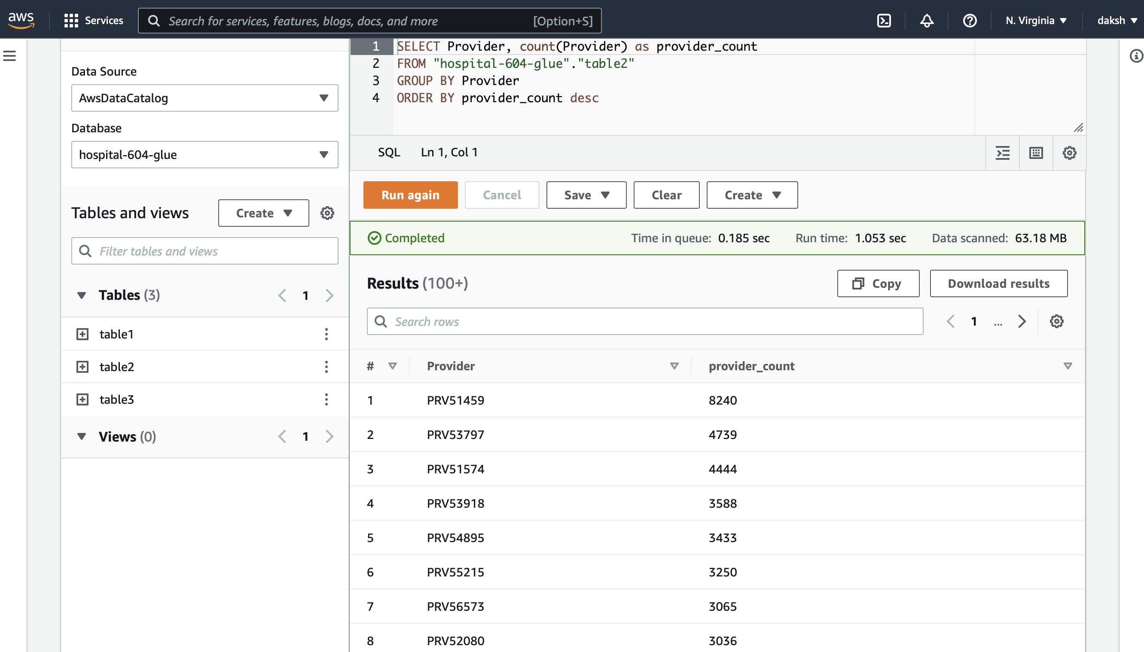
AWS

Slide 16
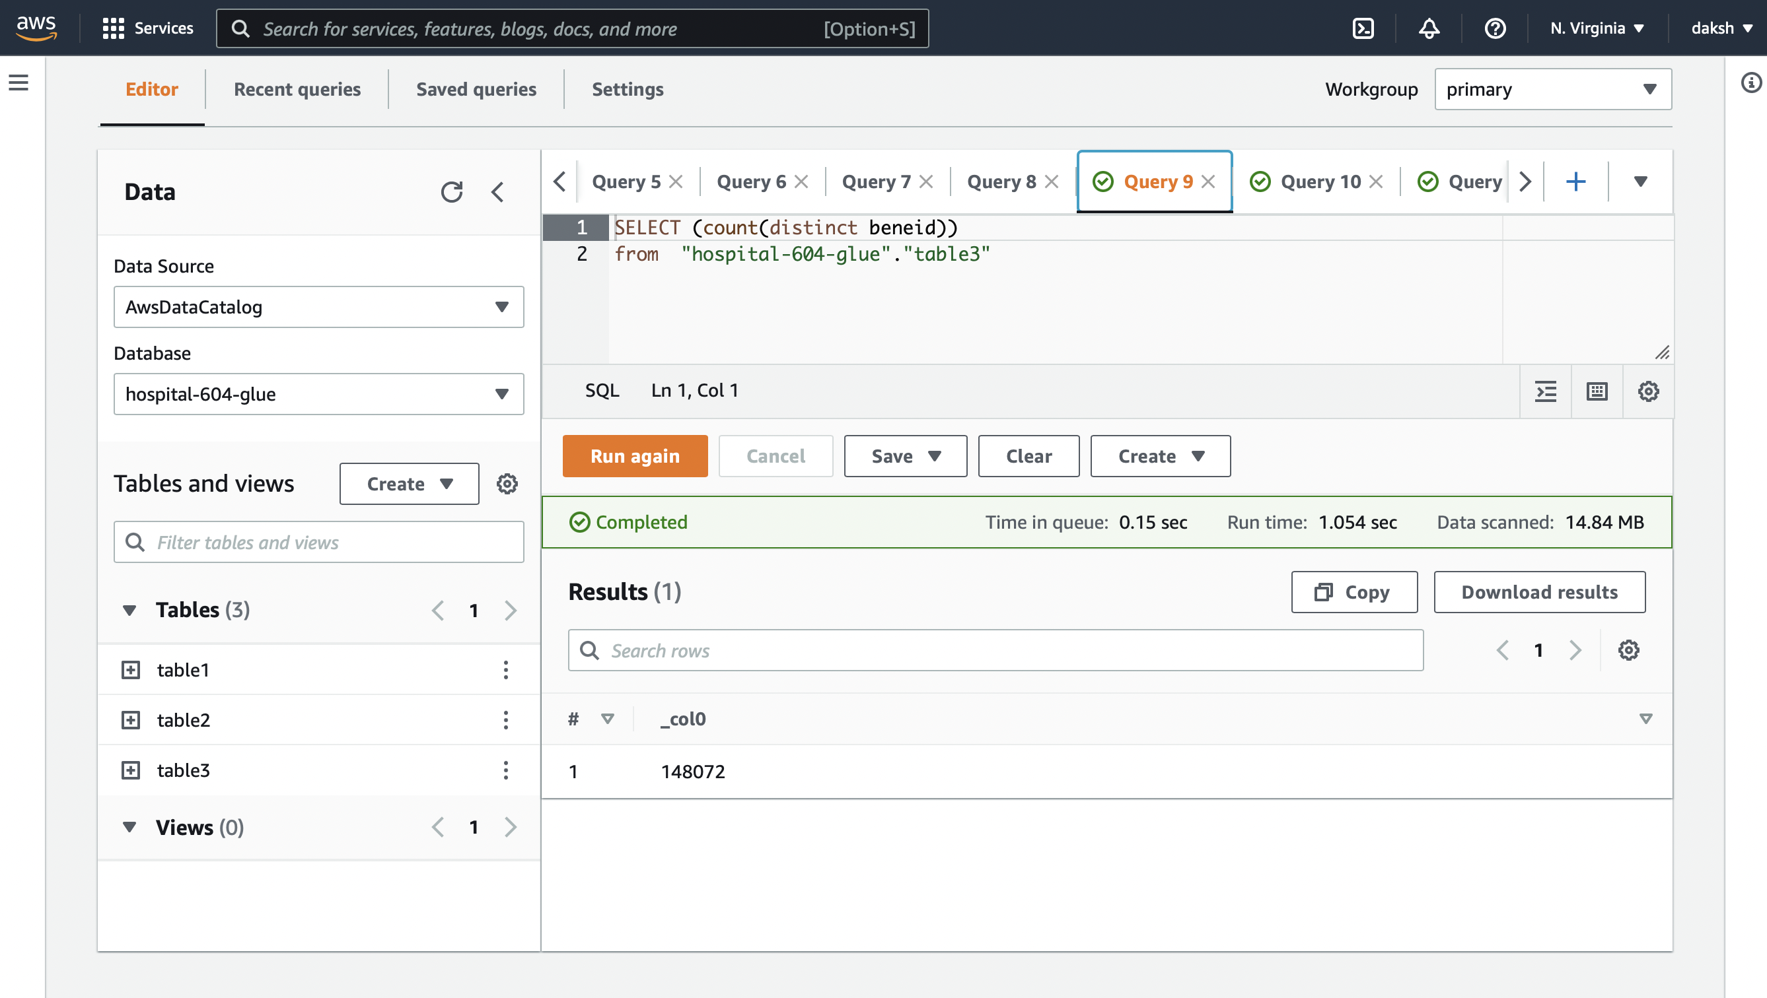
AWS

Slide 17
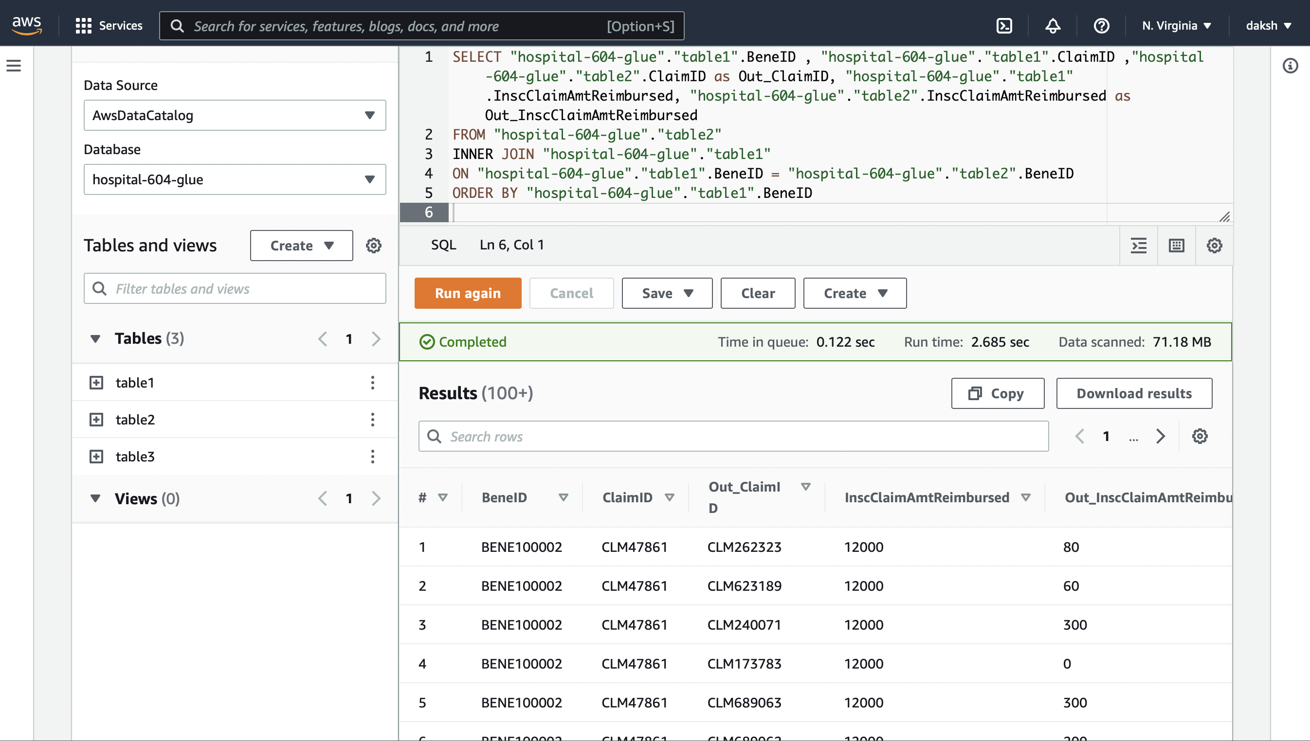
AWS

Slide 18
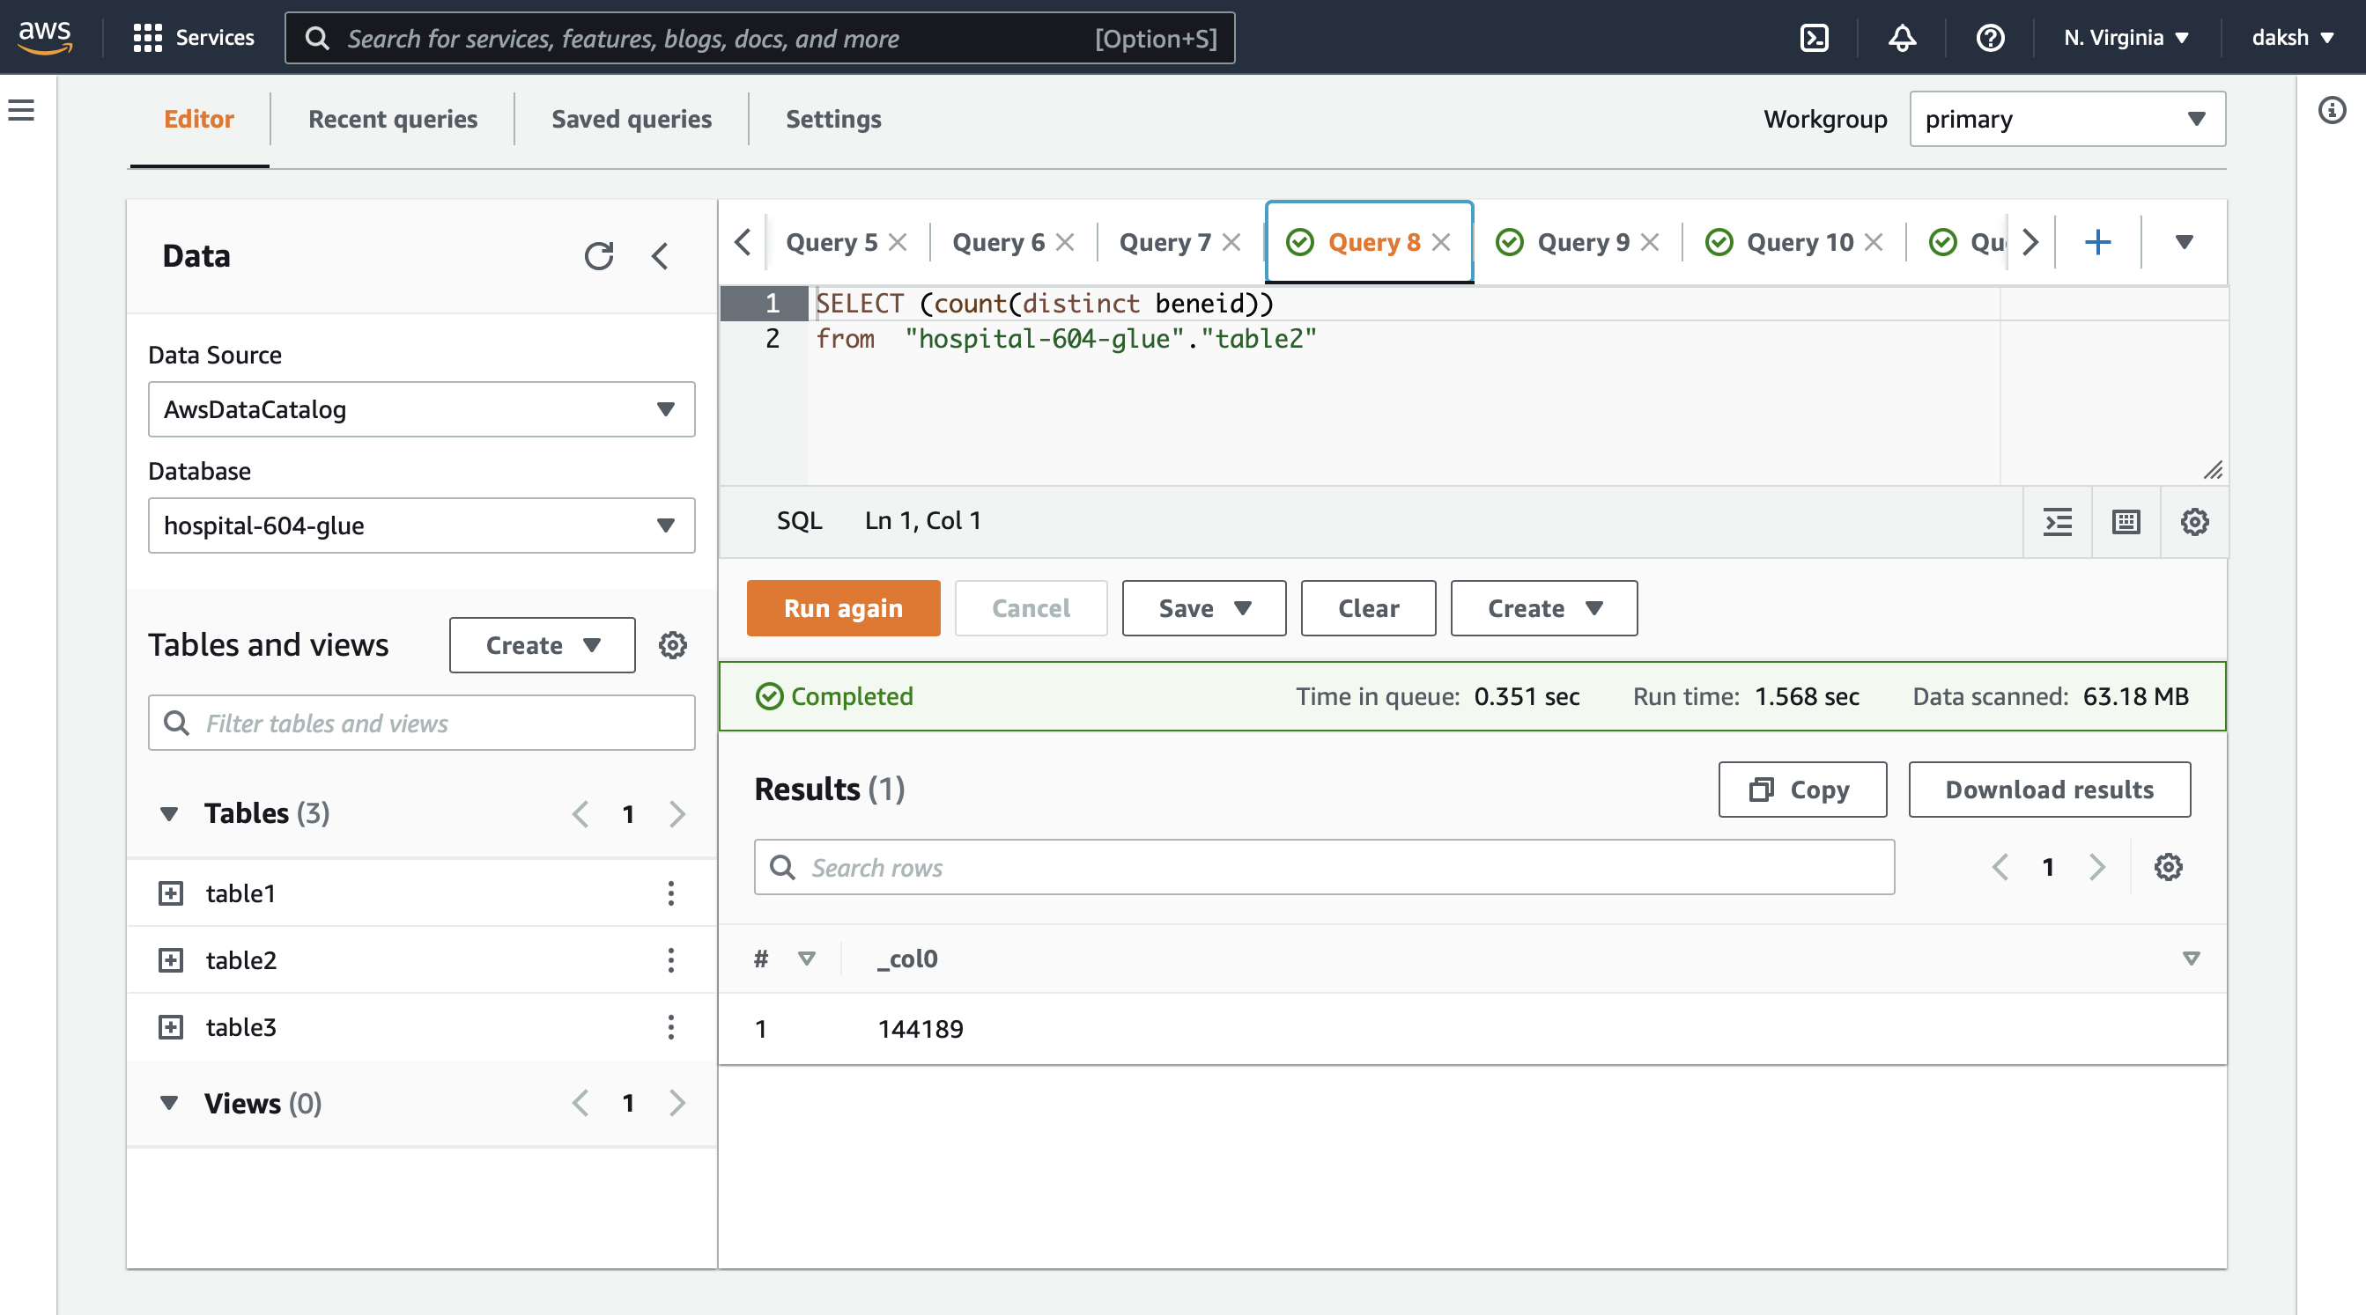
AWS

Slide 19
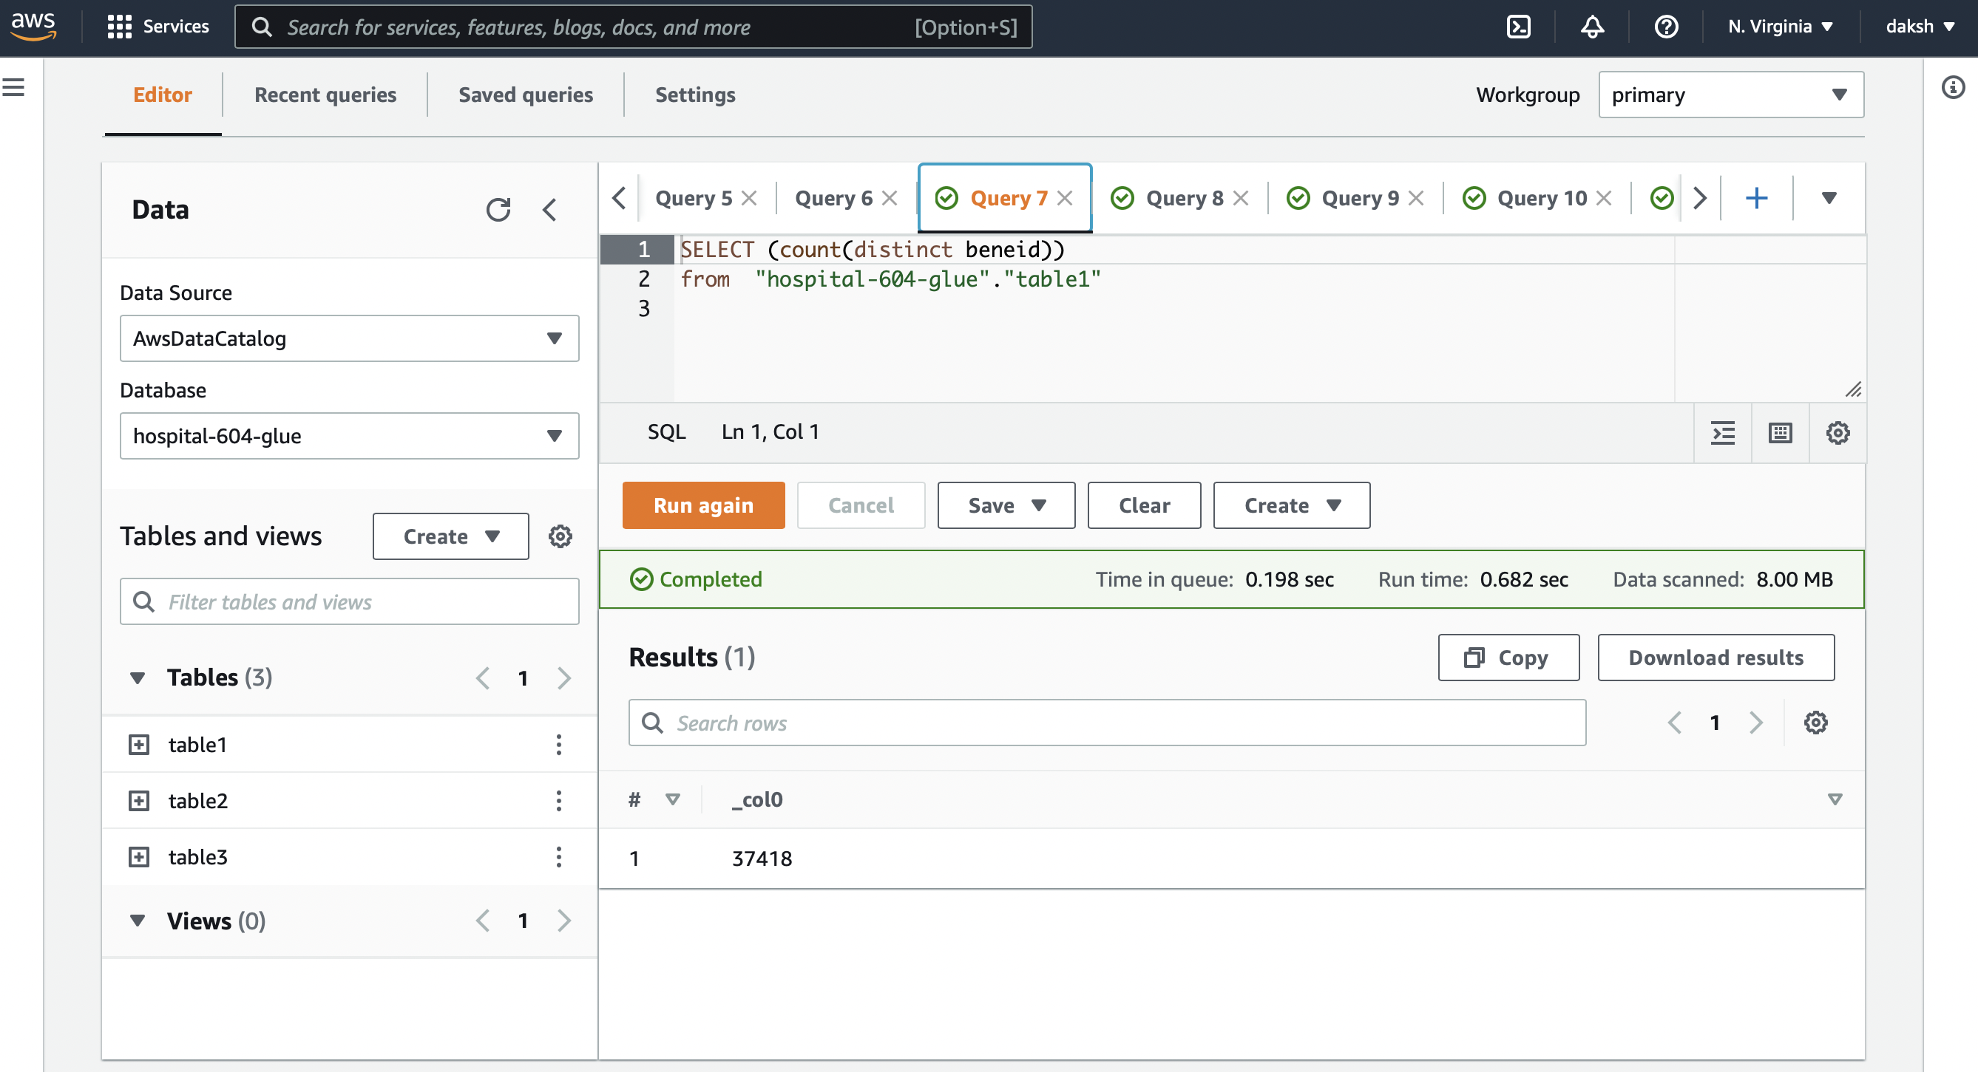
AWS

Slide 20
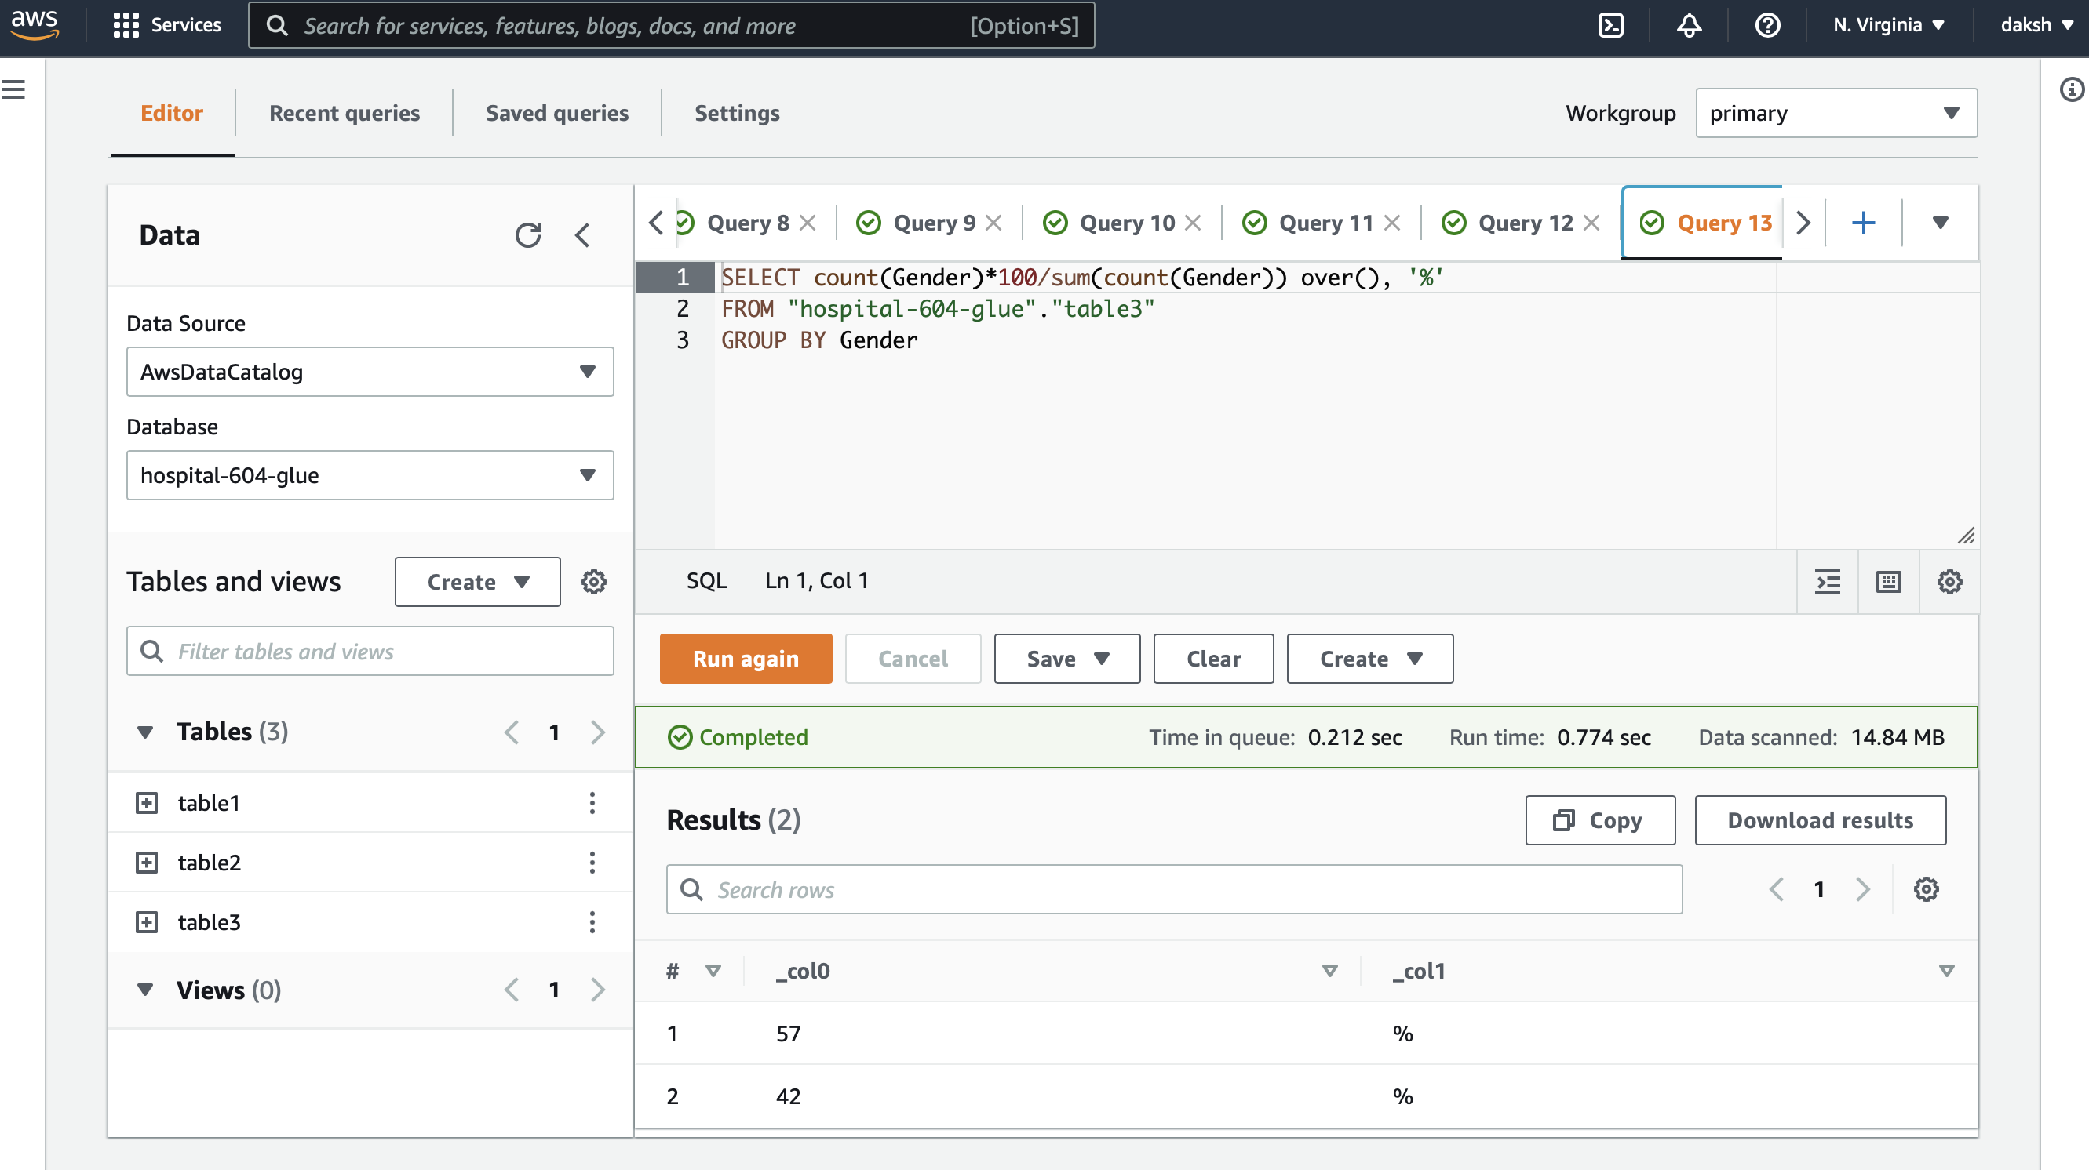
AWS

Slide 21
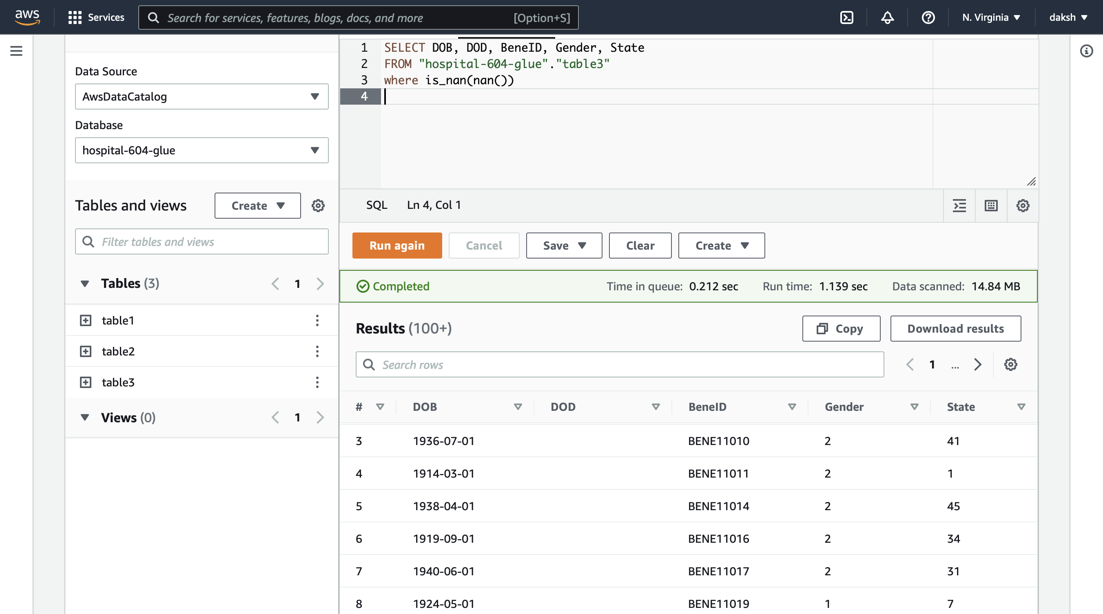
AWS

Slide 22
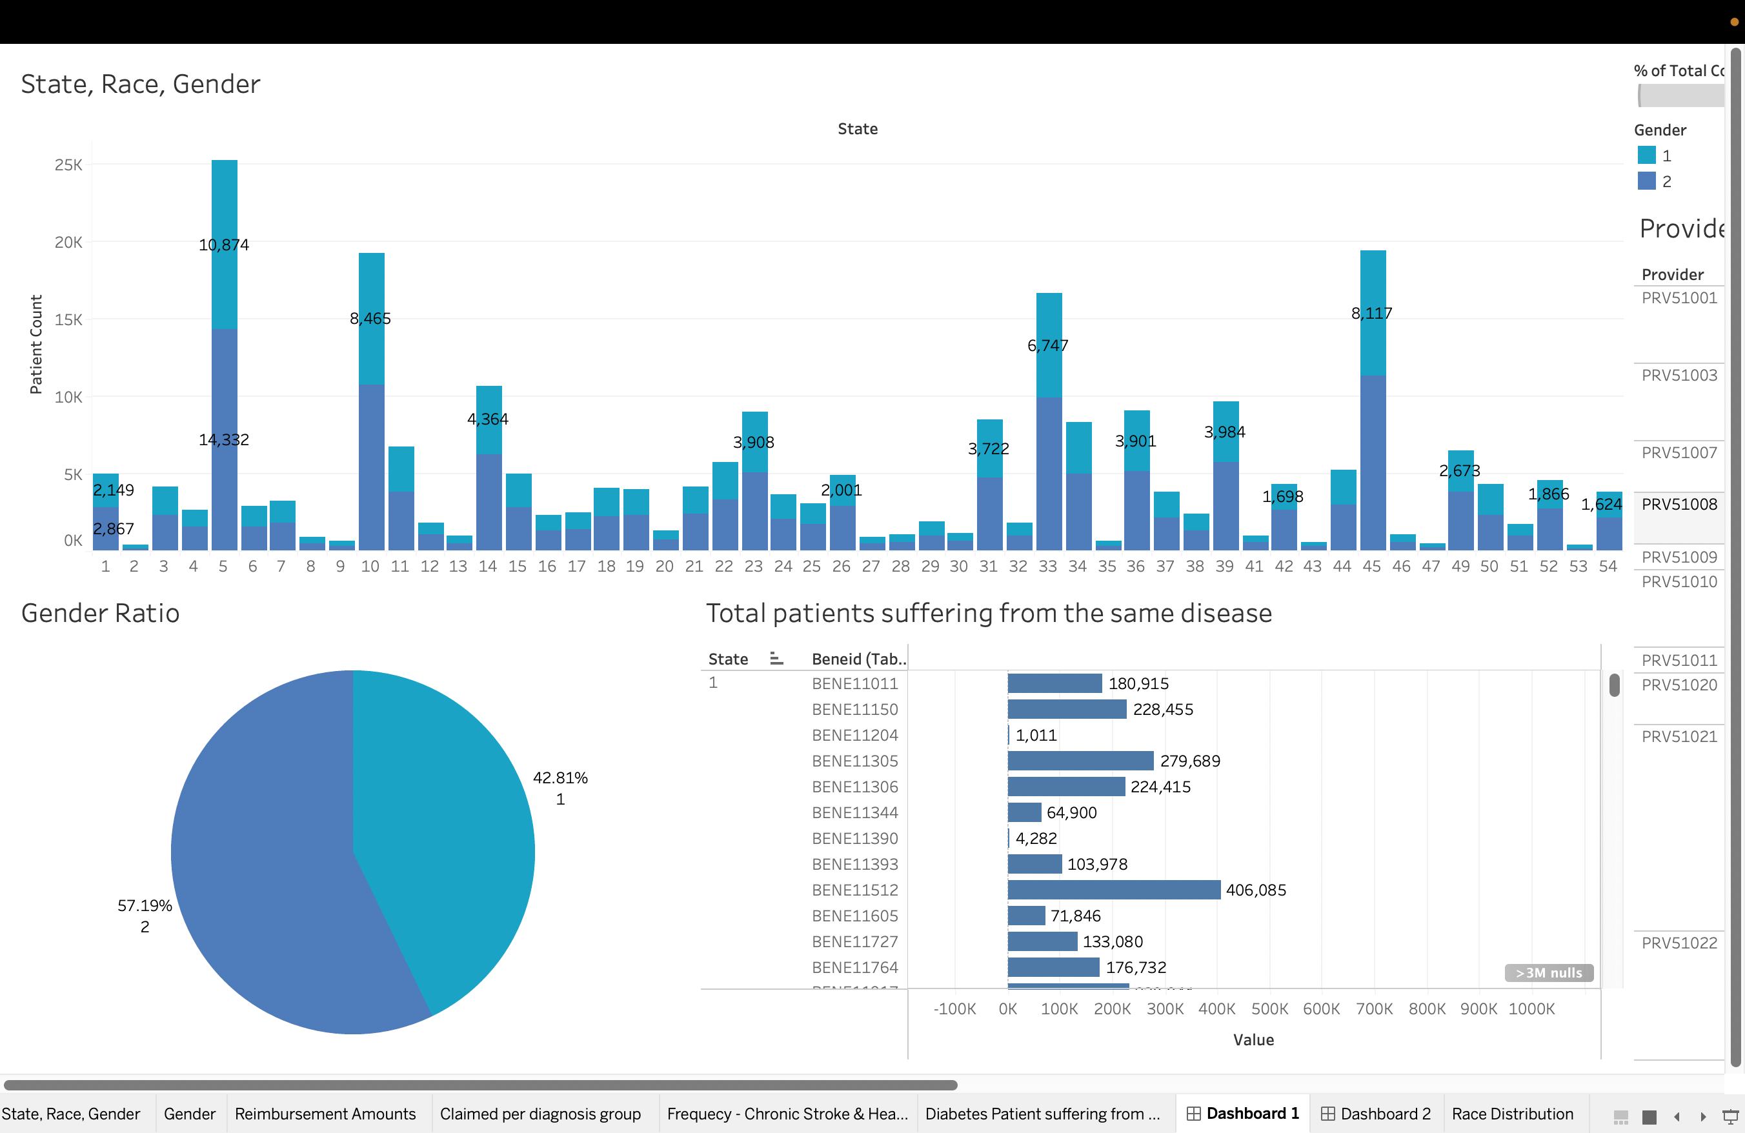
Dashboard-1

Slide 23
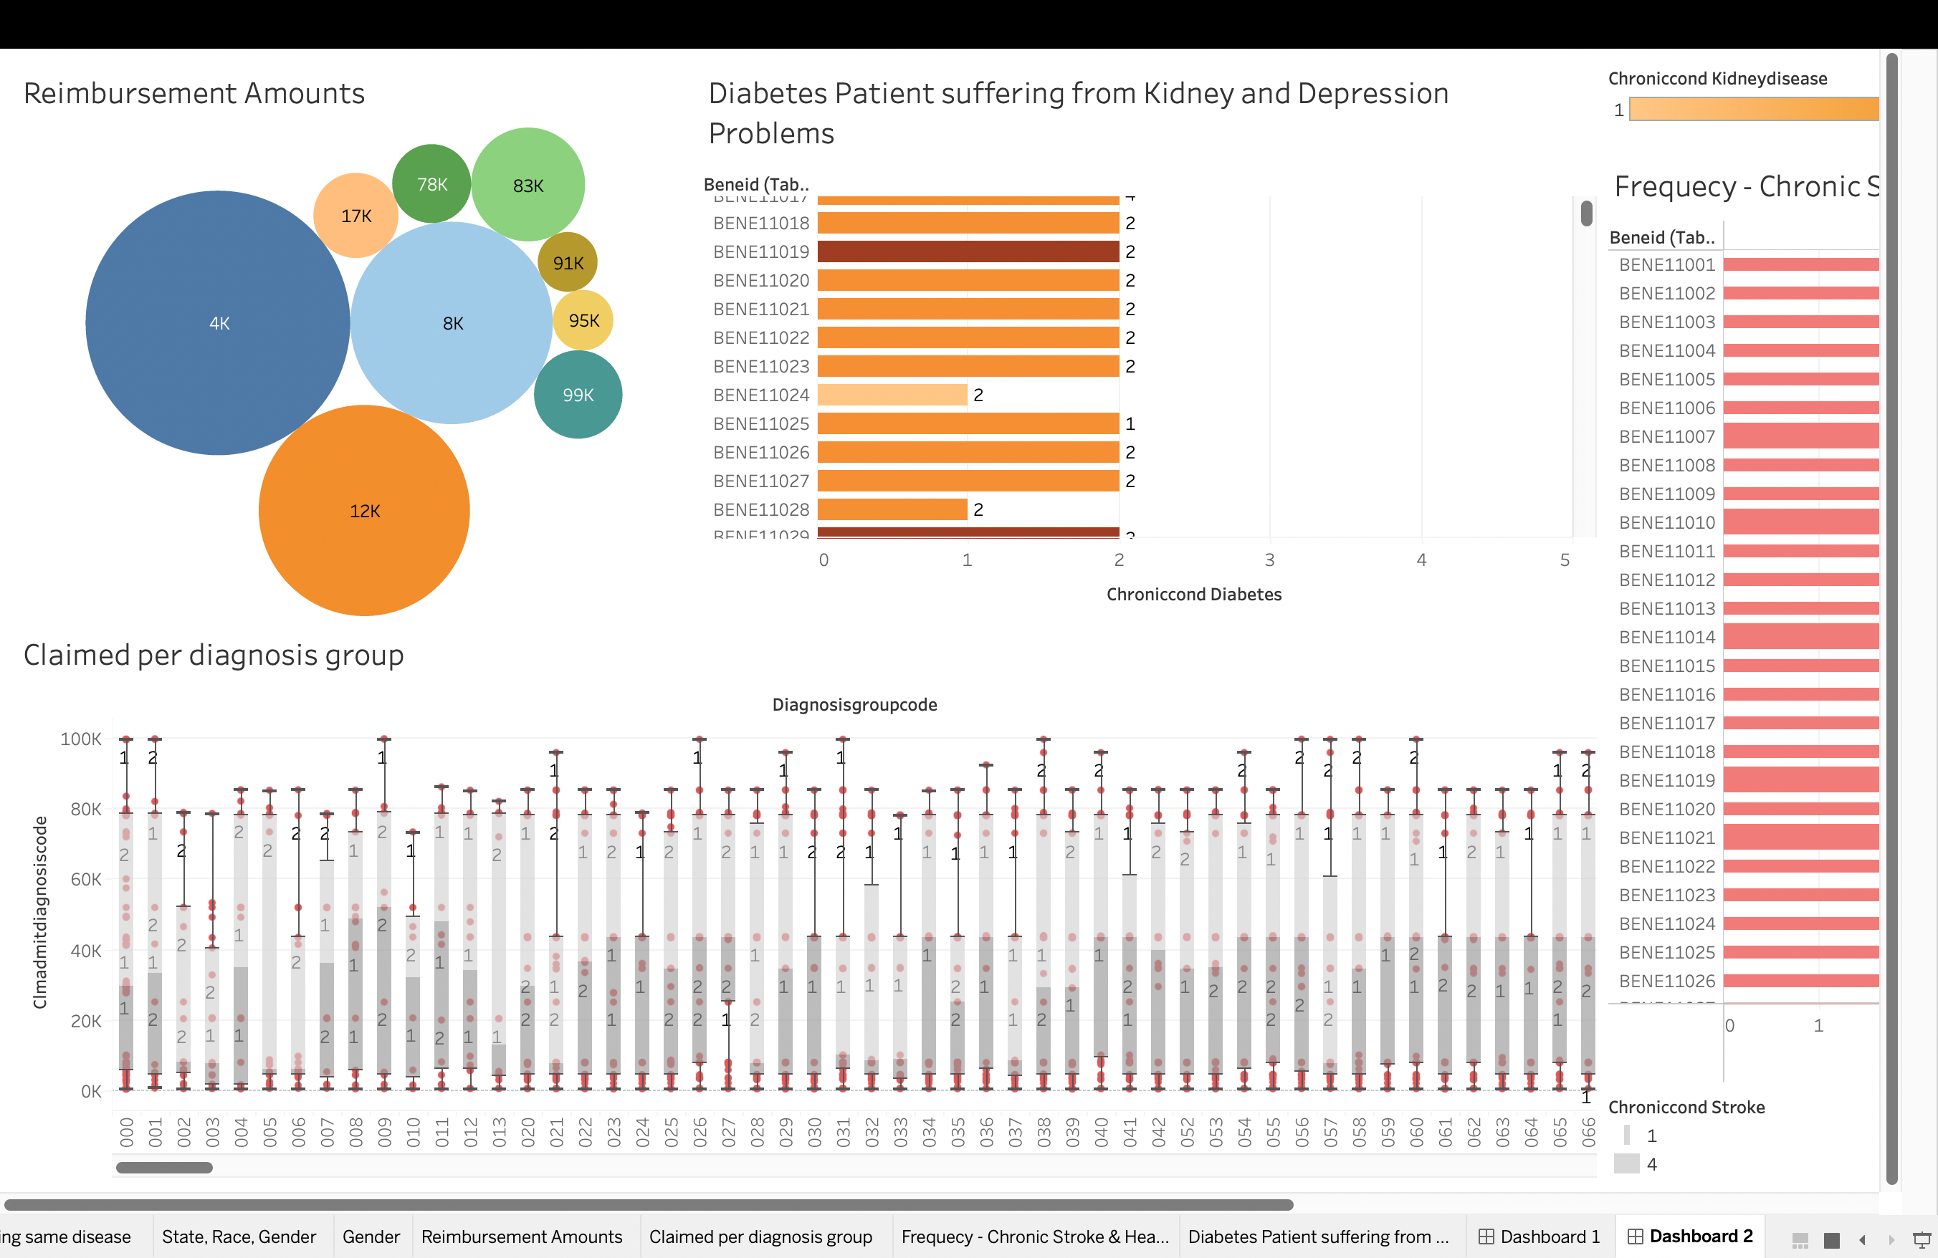
Dashboard-2

Slide 24
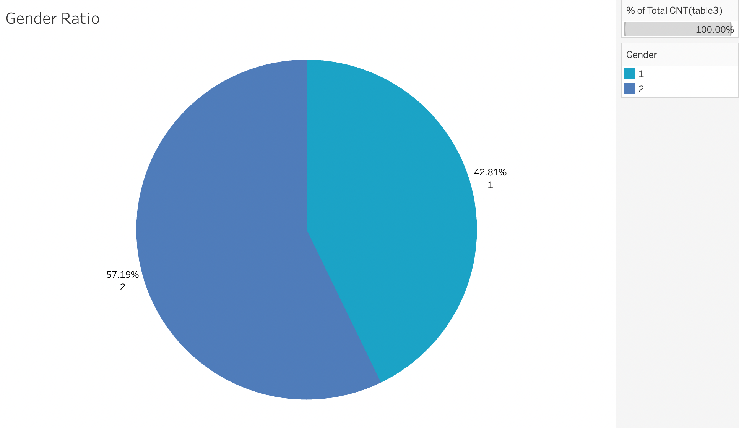
Data Analysis and Visualization

Slide 25
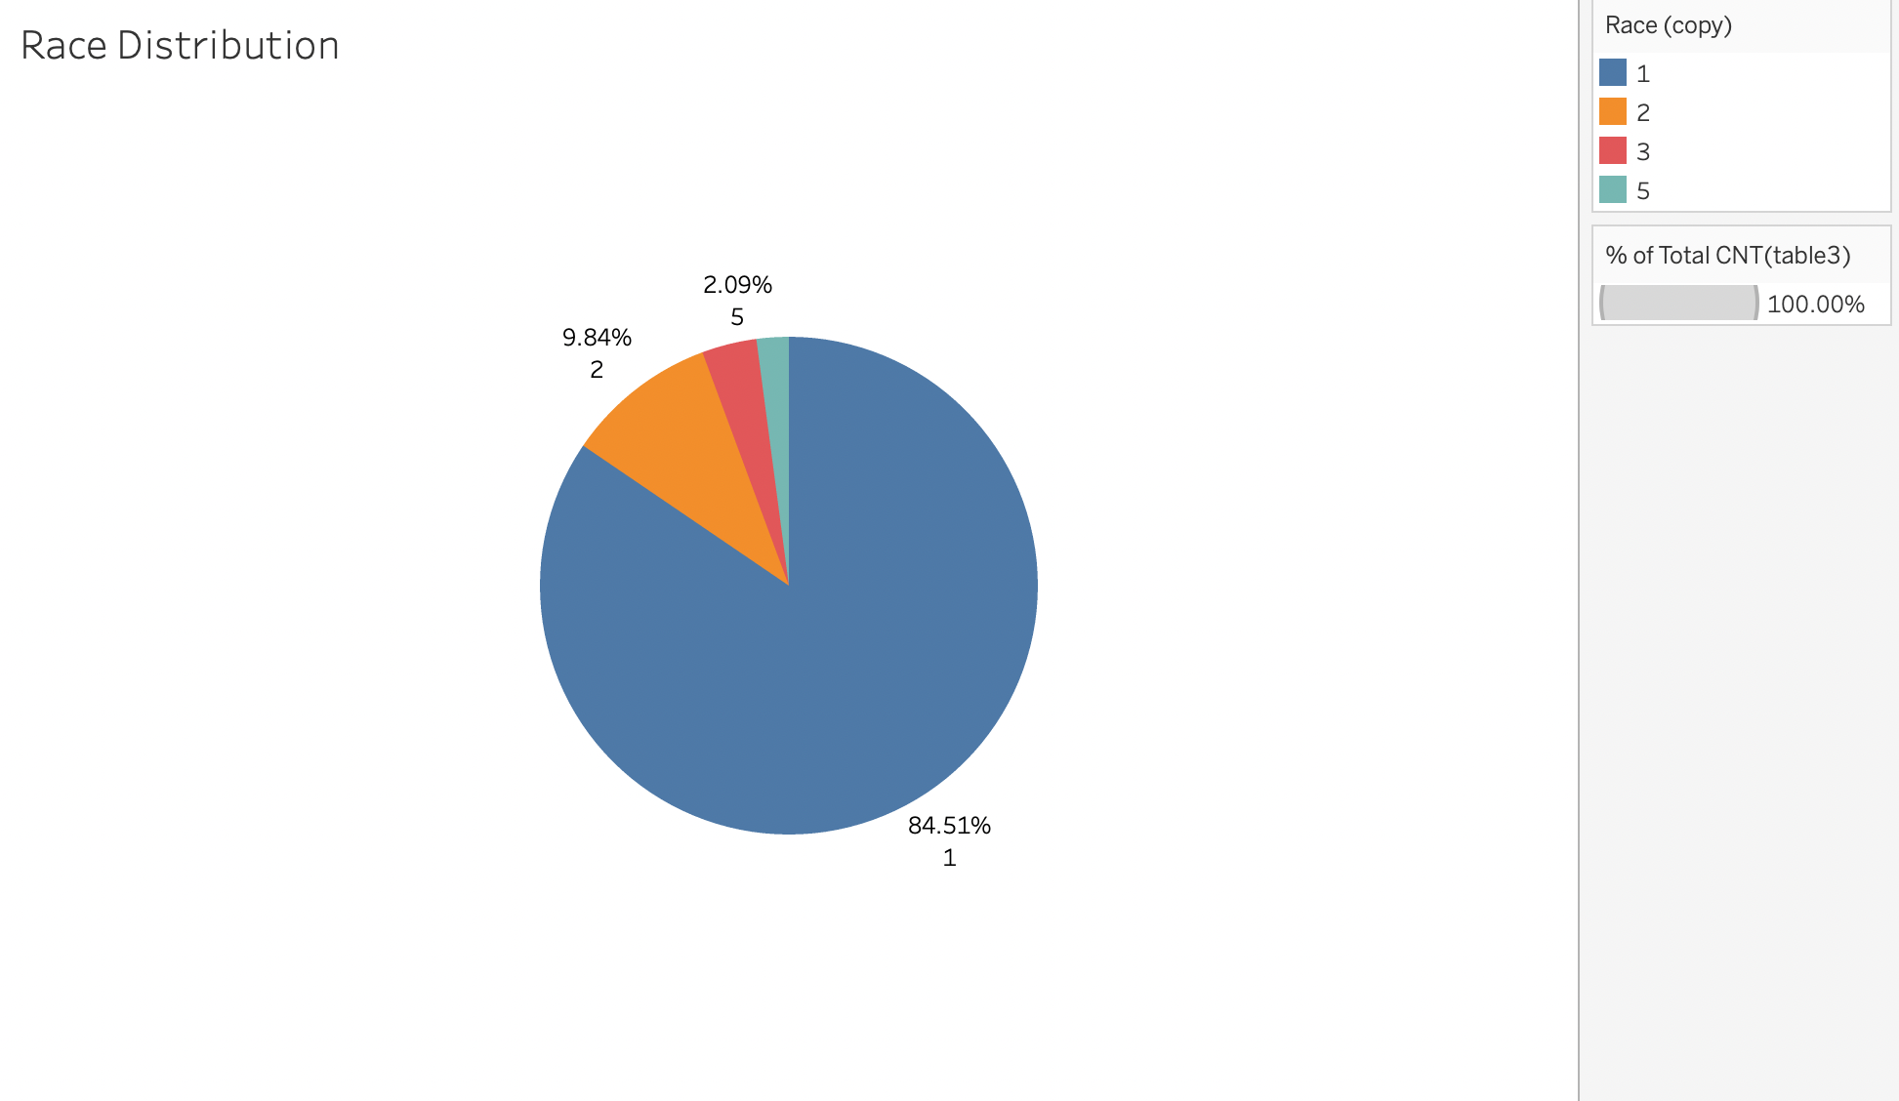
Data Analysis and Visualization

Slide 26
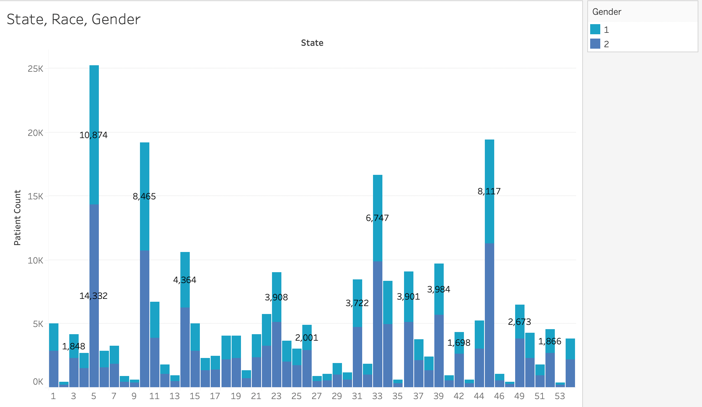
Data Analysis and Visualization

Slide 27
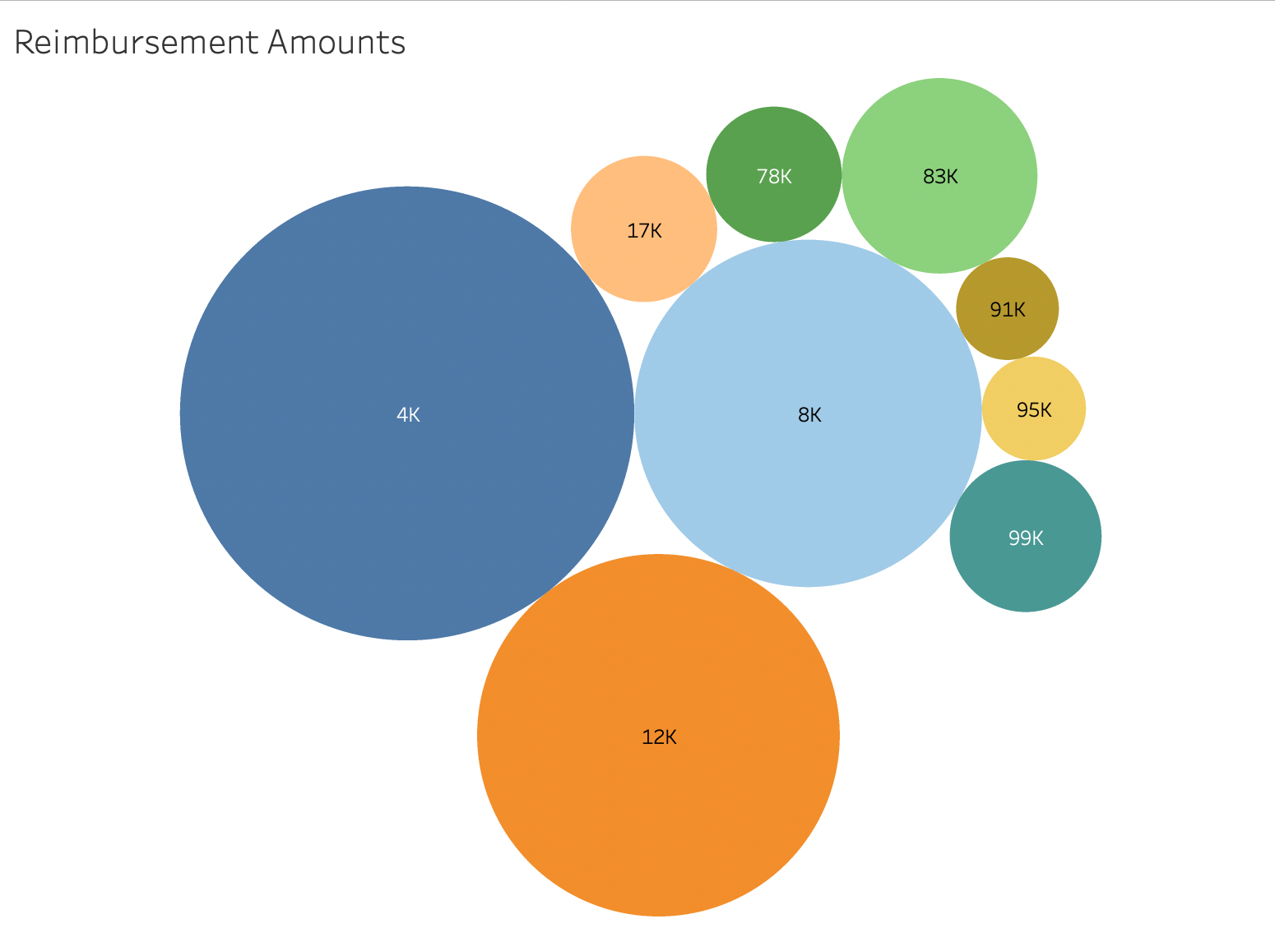
Data Analysis and Visualization

Slide 28
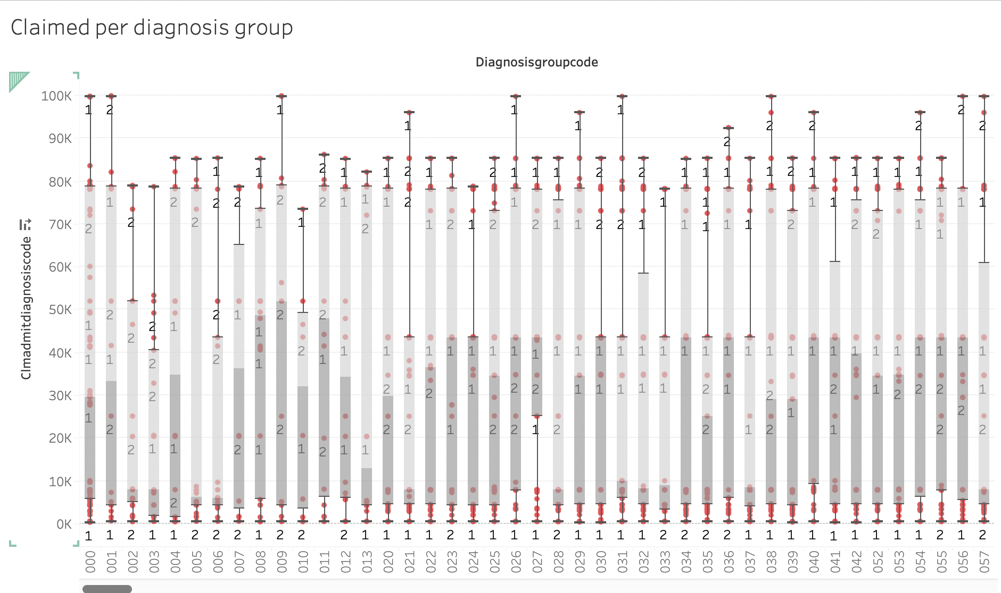
Data Analysis and Visualization

Slide 29
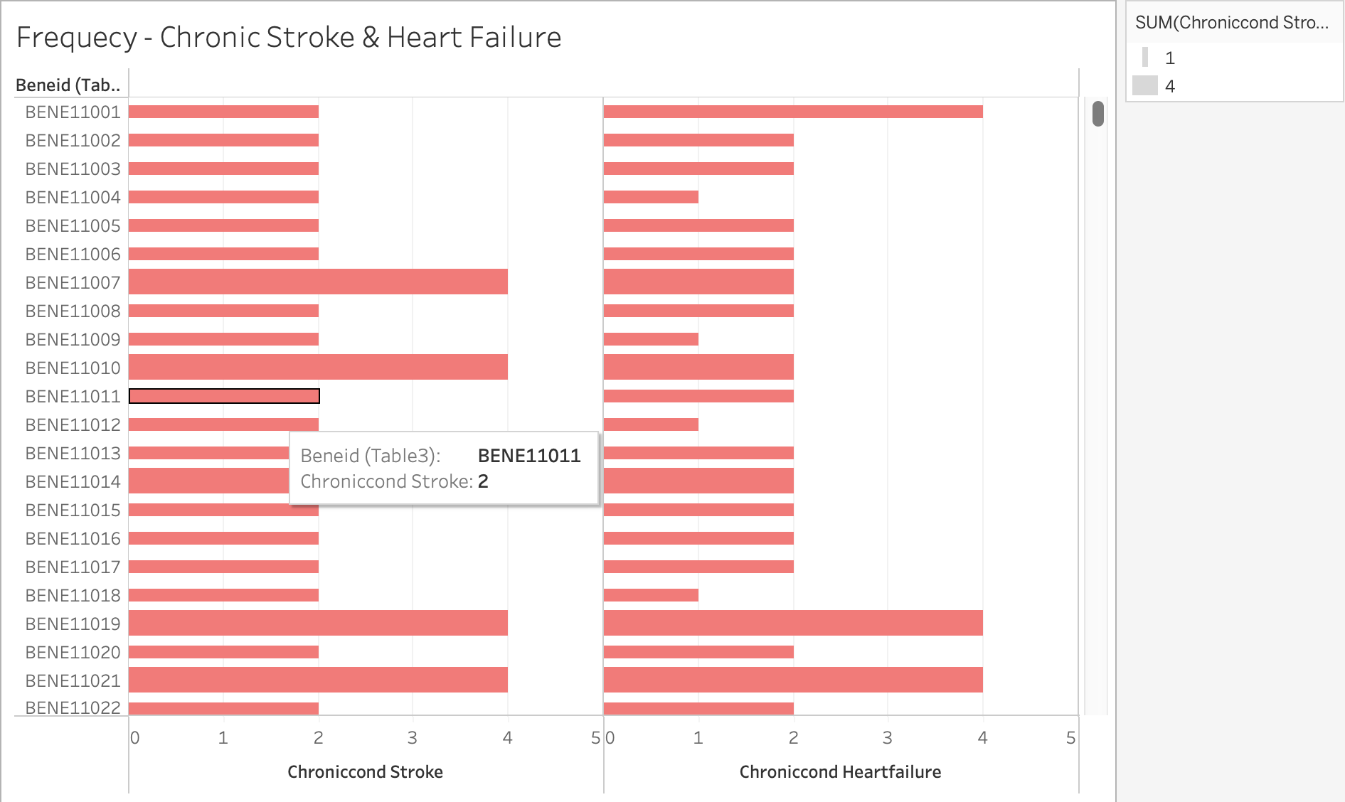
Data Analysis and Visualization

Slide 30
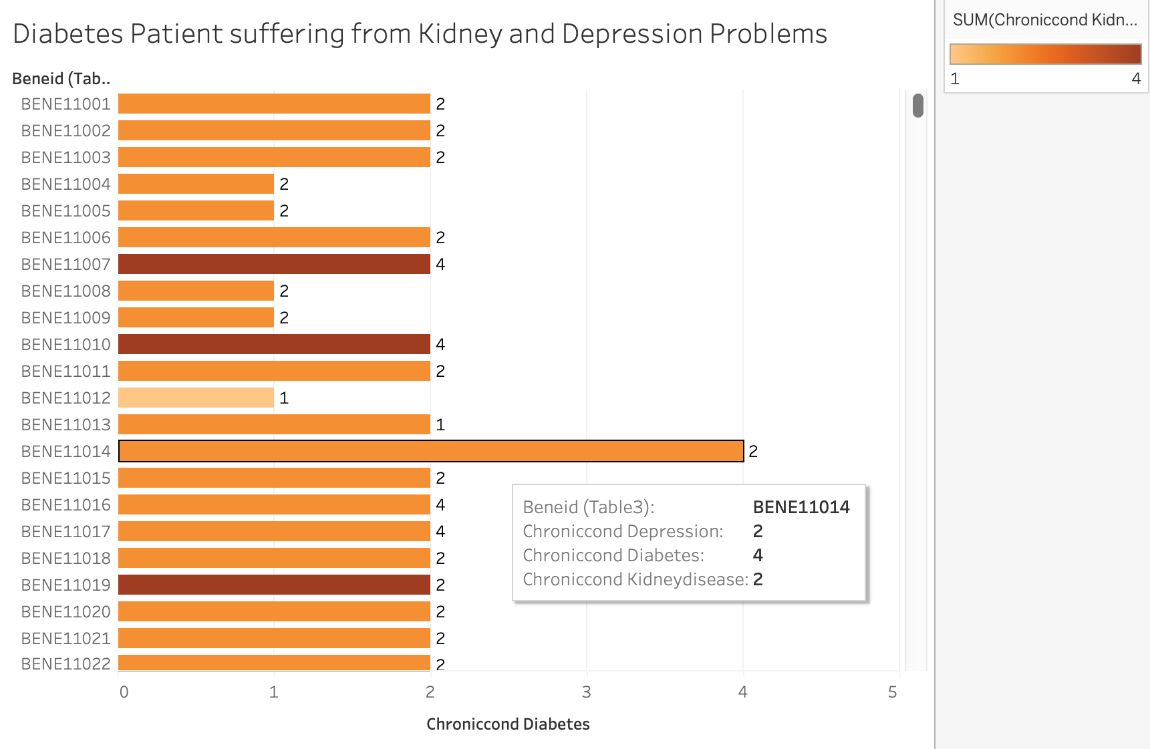
Data Analysis and Visualization

Slide 31
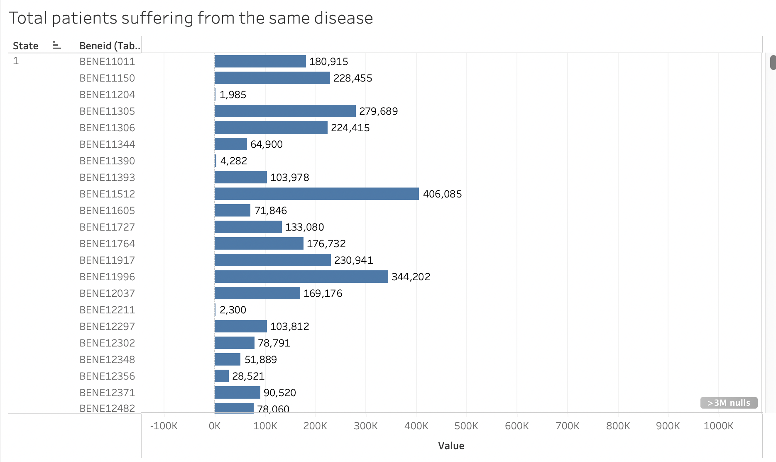
Data Analysis and Visualization

Slide 32
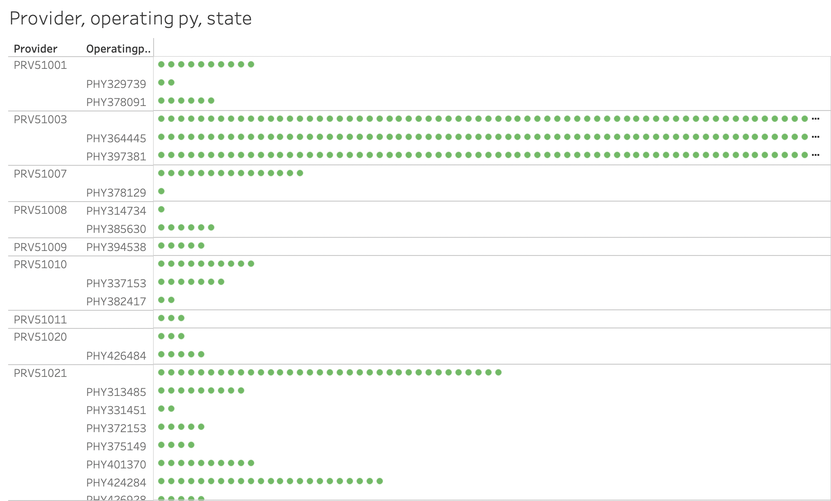
Data Analysis and Visualization

Slide 33
Project Conclusion
Understood the Inpatient & Outpatient Trend
Major Patients have claimed insurance for heart related sufferings
Patients claim their insurance multiple times
Strokes were more frequent than Heart Failure
Majority of the Reimbursement amount was around $4000
The insurances claimed had gender equality with 42-57%.

Slide 34
Learning Outcomes
AWS Clous Services
How to use Tableau to get data insights
Querying Data using AWS-Athena to get valuable information
Local Machine + Server Integration

Slide 35
Thank You.
FR
FABRIKAM RESIDENCES

Slide 36
References
How Many Americans Don’t Have Health Insurance In 2022?
https://www.simplyinsurance.com/how-many-americans-dont-have-health-insurance/
2. Galvani, A. P., Parpia, A. S., Foster, E. M., Singer, B. H., & Fitzpatrick, M. C. (2020). Improving the Prognosis of Healthcare in the United States. Lancet (London, England), 395(10223), 524.
https://doi.org/10.1016/S0140-6736(19)33019-3
3. Health insurance status Maryland population 2020 | Statista.
https://www.statista.com/statistics/238765/health-insurance-status-of-the-total-population-of-maryland/
4. Top 5 critical illness claims | BenefitsPRO.
https://www.benefitspro.com/2012/06/22/top-5-critical-illness-claims/?slreturn=20220416173943

